Slide 1
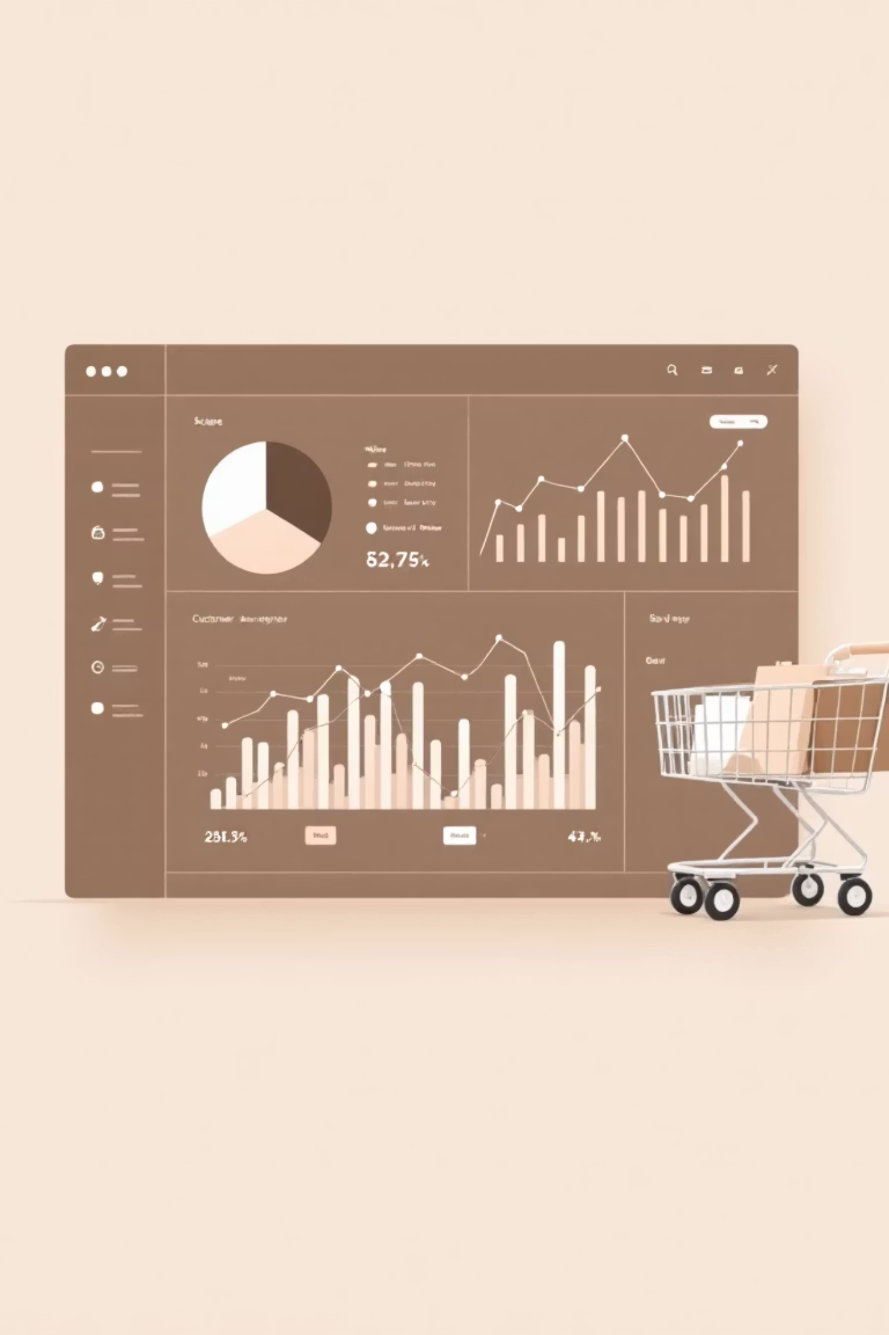
Customer Shopping Behavior Analysis
Uncovering insights from 3,900 purchases to drive strategic business decisions

Slide 2
Dataset Overview
3,900
18
$59.76
3.75
Total Purchases
Data Points
Average Purchase
Avg Rating
Transactions analyzed across all categories
Customer demographics and purchase details
Mean transaction value per customer
Customer satisfaction score
Key Features Tracked
Data Quality
Customer demographics
37 missing values in Review Rating column, imputed using median ratings by category
Purchase details & amounts
Shopping behavior patterns
Review ratings & shipping

Slide 3

Data Preparation Process
01
Data Loading & Exploration
Imported dataset, checked structure and summary statistics
02
Missing Data Handling
Imputed Review Rating nulls using category medians
03
Feature Engineering
Created age_group and purchase_frequency_days columns
04
Database Integration
Connected to PostgreSQL for advanced SQL analysis

Slide 4


Gender Revenue Gap
68%
32%
Male Revenue Share
Female Revenue Share
$157,890 total revenue from male customers
$75,191 total revenue from female customers
Male customers generate more than double the revenue of female customers

Slide 5
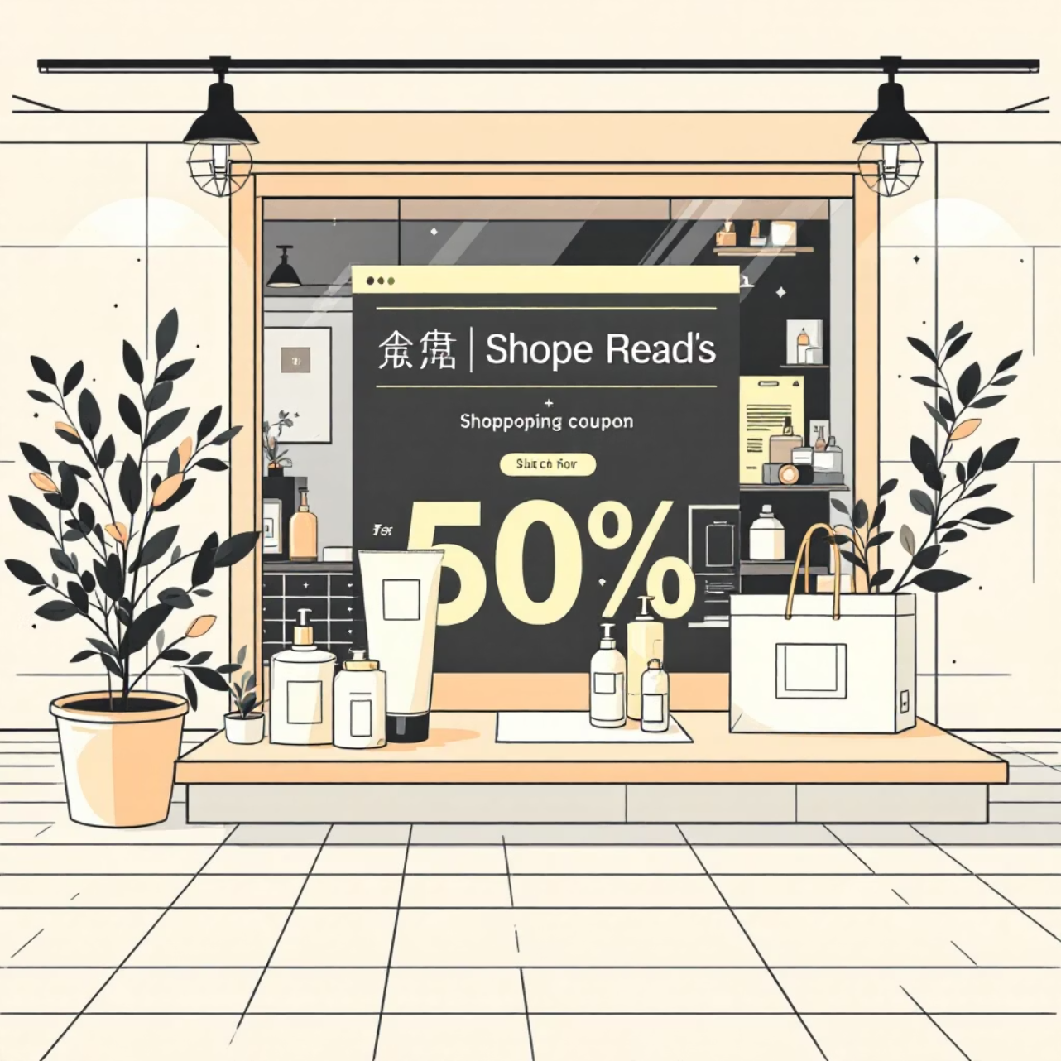
Smart Discount Users
839 customers used discounts but still spent above average
These high-value discount users represent a key segment—they respond to promotions while maintaining strong purchase amounts.
Purchase amounts: $62-$97
Above $59.76 average spend
Discount-responsive yet profitable

Slide 6
Top-Rated Products
1
2
3
Gloves
Sandals
Boots
3.86 average rating
3.84 average rating
3.82 average rating
4
5
Hat
Skirt
3.80 average rating
3.78 average rating

Slide 7



Customer Segmentation Insights
1
New (83)
2
Returning (701)
3
Loyal (3,116)
Subscription Status
Repeat Buyers
Shipping Preference
27% subscribed
958 subscribers with 5+ purchases
Express: $60.48 avg
73% non-subscribers
2,518 non-subscribers with 5+ purchases
Standard: $58.46 avg

Slide 8
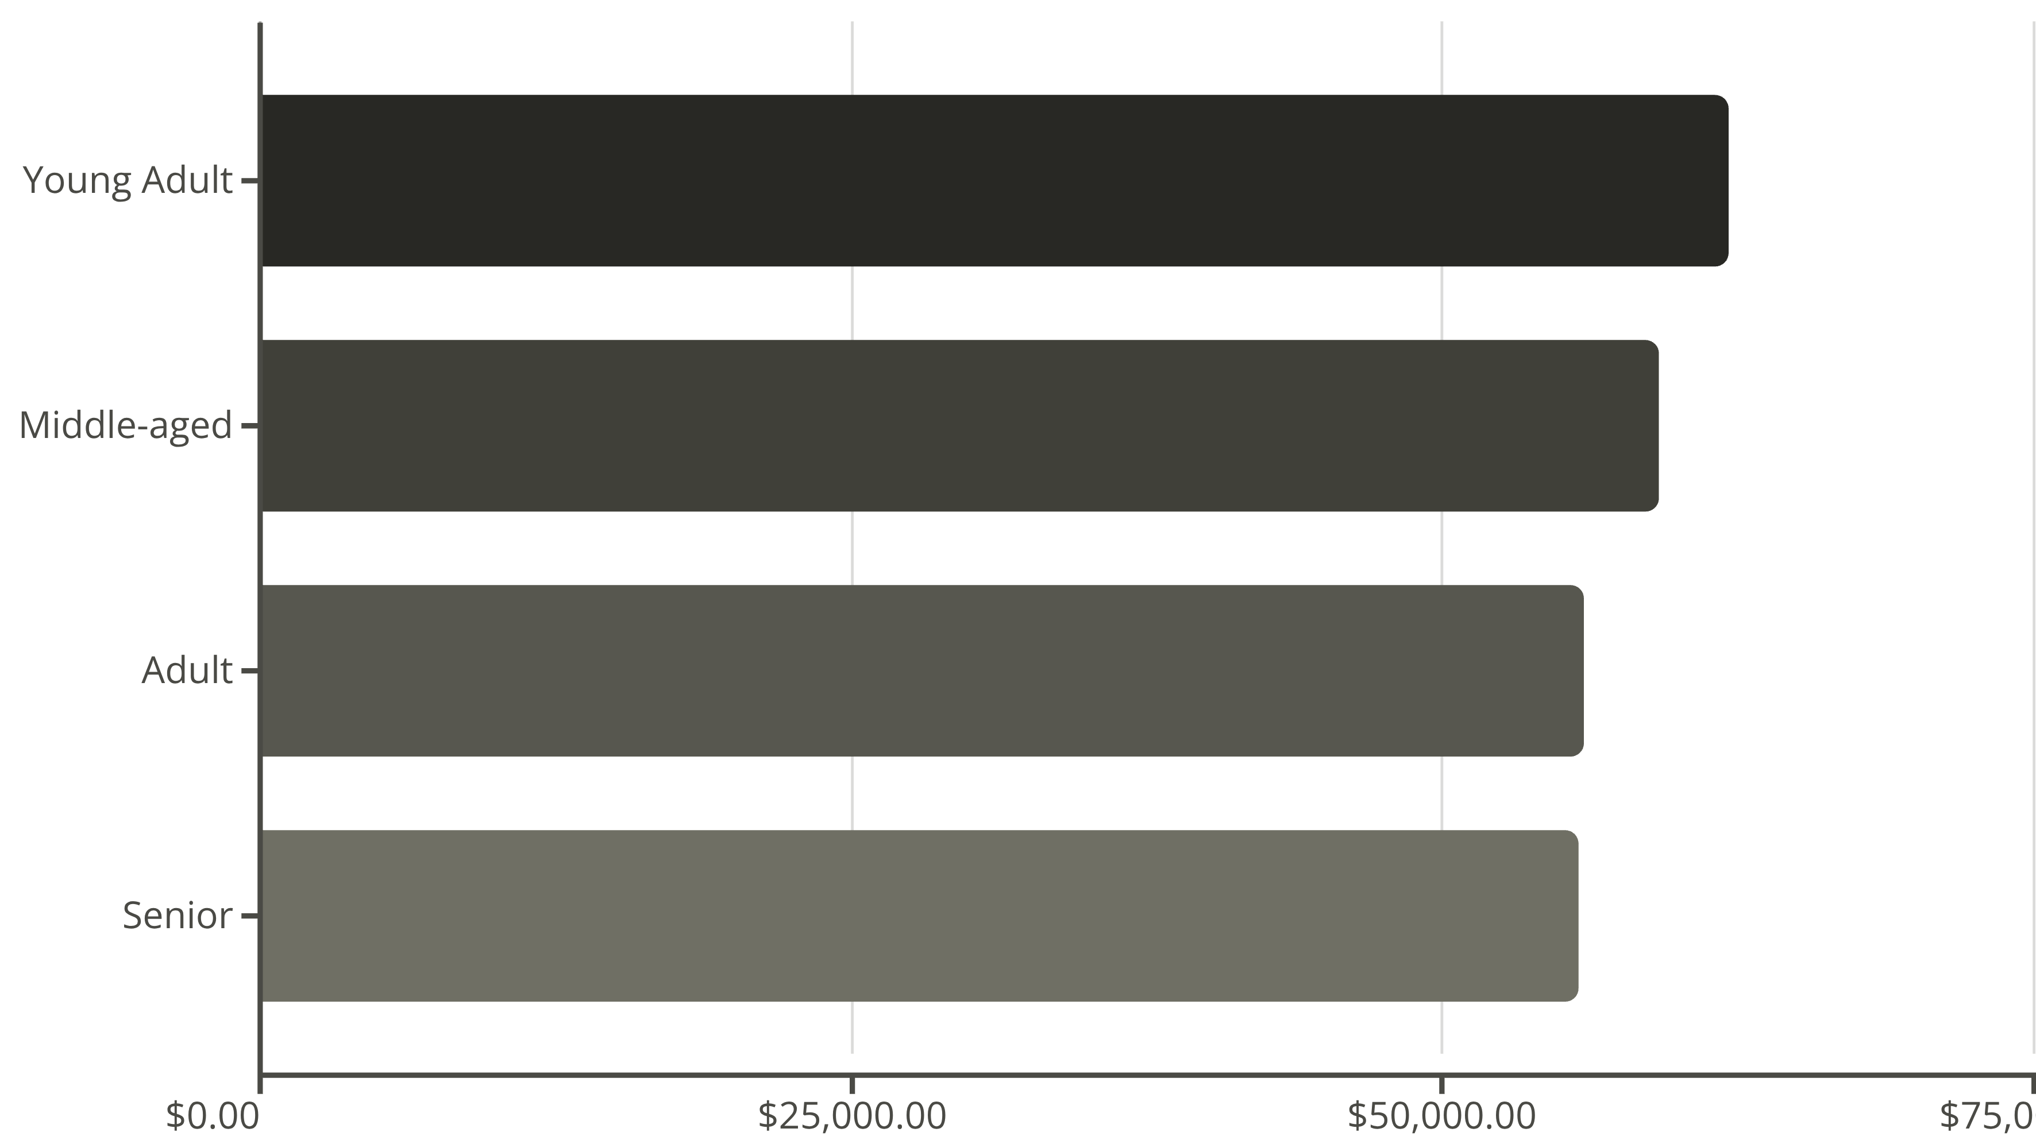
Revenue by Age Group
Young adults drive highest revenue, followed closely by middle-aged customers

Slide 9
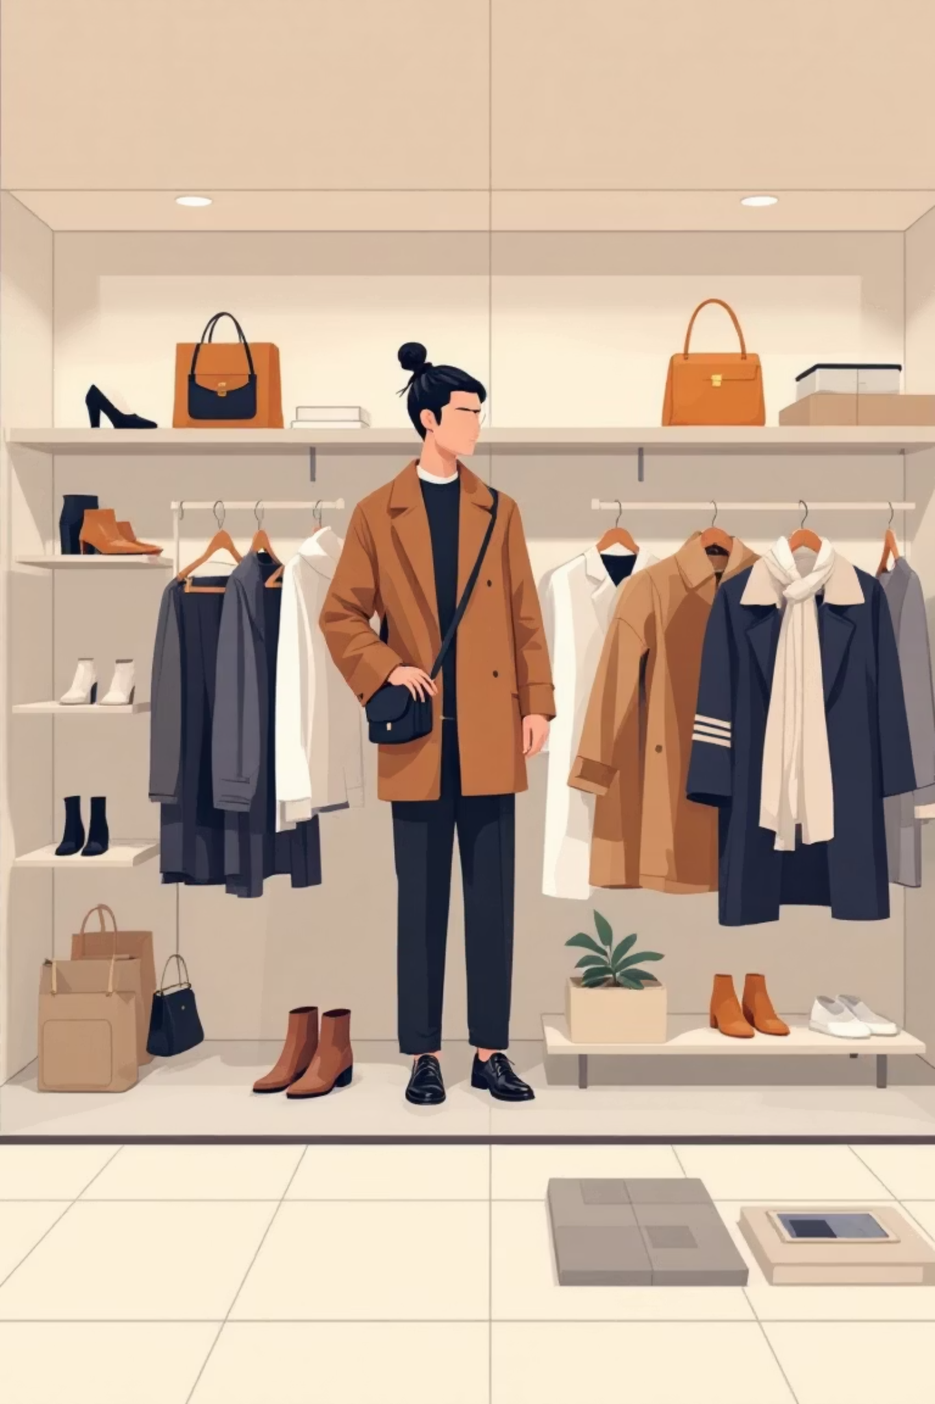
Category Performance
Top Products by Category
Footwear
Sandals (160 orders)
Accessories
Shoes (150)
Jewelry (171 orders)
Sneakers (145)
Sunglasses (161)
Outerwear
Belt (161)
Jacket (163 orders)
Clothing
Coat (161)
Blouse (171 orders)
Pants (171)
Shirt (169)

Slide 10

Strategic Recommendations
Boost Subscriptions
Loyalty Programs
Review Discount Policy
Promote exclusive benefits to convert 73% non-subscribers
Reward repeat buyers to grow loyal segment
Balance sales boosts with margin control for 50% discount rate items
Product Positioning
Targeted Marketing
Highlight top-rated products like Gloves and Sandals in campaigns
Focus on high-revenue young adults and express-shipping users

